Slide 1
Exercise with MetDA
Sili Fan WCMC statistician

Slide 2
MetDA online
http://metda.fiehnlab.ucdavis.edu/

Slide 3
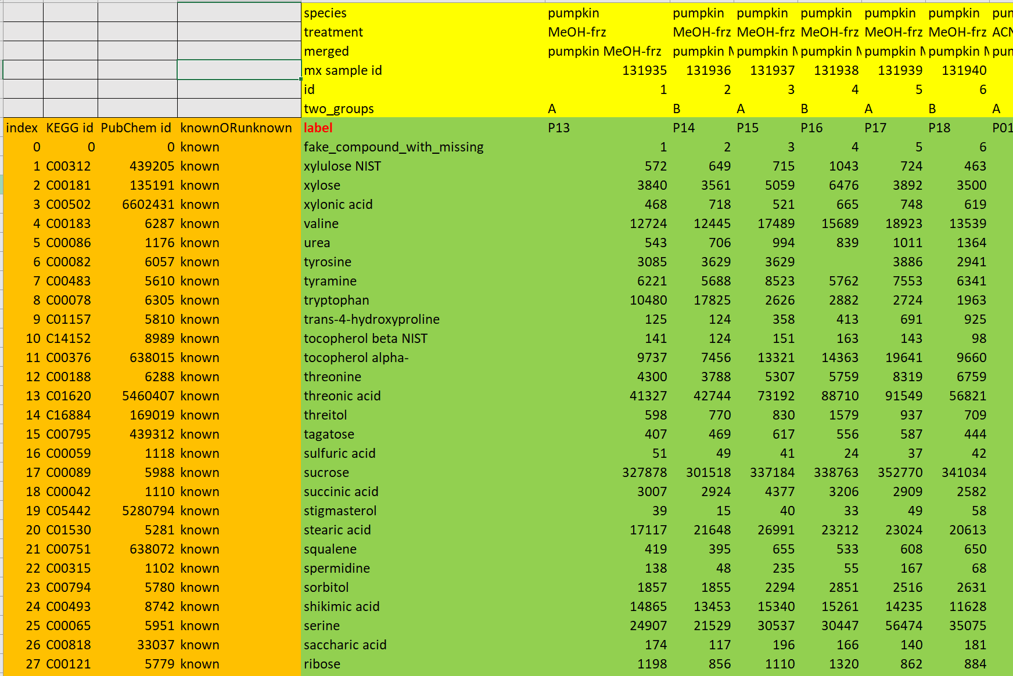
Input format
First sheet of a .xlsx file.
At least to have one column of compound information and one row of sample information
Gray area must be empty.

Slide 4
Citation
Wanichthanarak, K., Fan, S., Grapov, D., Barupal, D. K., & Fiehn, O. (2017). Metabox: a toolbox for metabolomic data analysis, interpretation and integrative exploration. PLoS One, 12(1), e0171046.

